Slide 1
OS storage

Slide 2
Storage Structure
Main memory – only large storage media that the CPU can access directly
Random access
Typically volatile
Typically random-access memory in the form of Dynamic Random-access Memory (DRAM)
Secondary storage – extension of main memory that provides large nonvolatile storage capacity

Slide 3
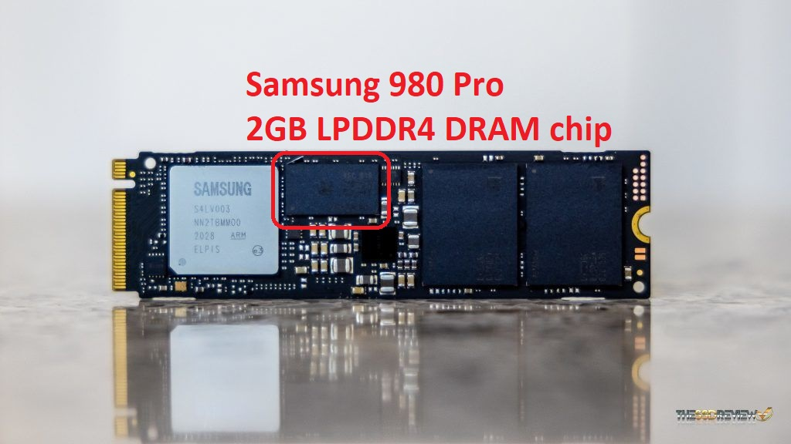
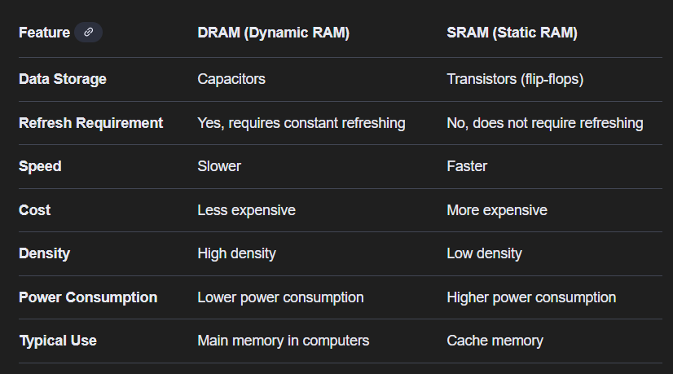
RAM vs DRAM
DRAM is dedicated RAM on the SSD and is used as a type of cache/buffer to make the drive faster.

Slide 4
Hard Disk Drives (HDD) – rigid metal or glass platters covered with magnetic recording material
Disk surface is logically divided into tracks, which are subdivided into sectors
The disk controller determines the logical interaction between the device and the computer
Non-volatile memory (NVM) devices– faster than hard disks, nonvolatile
Various technologies
Becoming more popular as capacity and performance increases, price drops

Slide 5
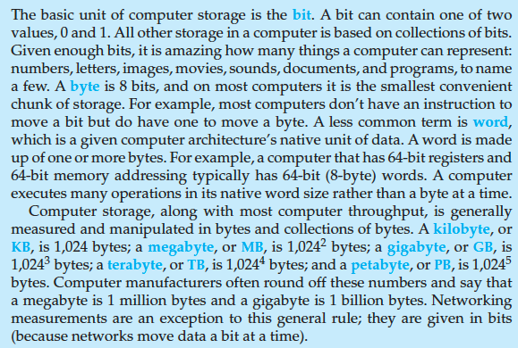
Storage Definitions and Notation Review
The basic unit of computer storage is the bit. A bit can contain one of two
values, 0 and 1. All other storage in a computer is based on collections of bits.
Given enough bits, it is amazing how many things a computer can represent:
numbers, letters, images, movies, sounds, documents, and programs, to name
a few. A byte is 8 bits, and on most computers it is the smallest convenient
chunk of storage. For example, most computers don’t have an instruction to
move a bit but do have one to move a byte. A less common term is word,
which is a given computer architecture’s native unit of data. A word is made
up of one or more bytes. For example, a computer that has 64-bit registers and
64-bit memory addressing typically has 64-bit (8-byte) words. A computer
executes many operations in its native word size rather than a byte at a time.
Computer storage, along with most computer throughput, is generally
measured and manipulated in bytes and collections of bytes. A kilobyte, or
KB , is 1,024 bytes; a megabyte, or MB, is 1,024² bytes; a gigabyte, or GB, is
1,024³ bytes; a terabyte, or TB, is 1,024⁴ bytes; and a petabyte, or PB, is 1,024⁵
bytes. Computer manufacturers often round off these numbers and say that
a megabyte is 1 million bytes and a gigabyte is 1 billion bytes. Networking
measurements are an exception to this general rule; they are given in bits
(because networks move data a bit at a time).

Slide 6
Storage Hierarchy
Storage systems organized in hierarchy
Speed
Cost
Volatility
Caching – copying information into faster storage system; main memory can be viewed as a cache for secondary storage
Device Driver for each device controller to manage I/O
Provides uniform interface between controller and kernel

Slide 7
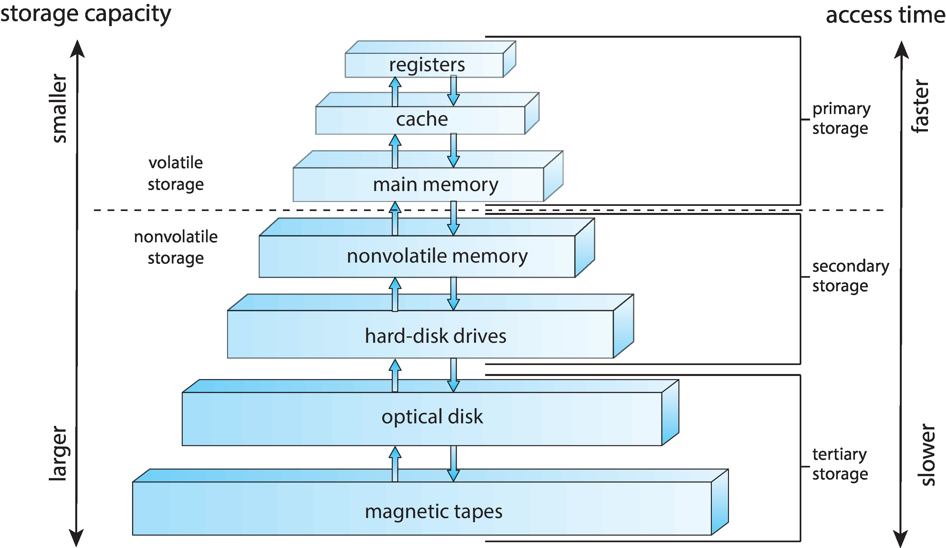
Storage-Device Hierarchy

Slide 8
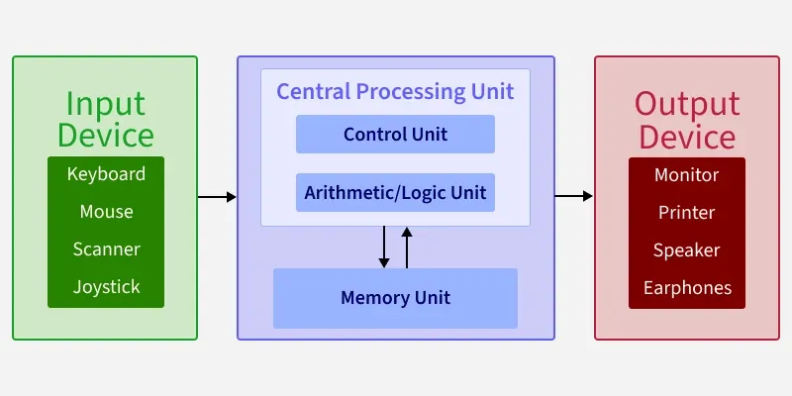
Von Neumann architecture
Von Neumann architecture is a computer design where instructions and data are stored in the same memory space. This means the CPU fetches both instructions and data from the same memory, using the same pathways.

Slide 9
Direct Memory Access Structure
Used for high-speed I/O devices able to transmit information at close to memory speeds
Device controller transfers blocks of data from buffer storage directly to main memory without CPU intervention
Only one interrupt is generated per block, rather than the one interrupt per byte

Slide 10
What Is Buffer Storage?
Buffer storage is a temporary memory area used to hold data while it is being transferred between two locations for example, between a slow device and fast main memory.
It acts as a “holding area” or “staging area” to smooth out differences in speed between:
Input/Output devices (slow, like disks)
and
Main memory (fast, like RAM)
Example:
When reading from a hard drive:
Data is first read from the disk into the buffer storage (a part of the disk controller or memory).
Then the DMA controller transfers the entire block of data from the buffer to main memory.
Once the whole block transfer is done, one interrupt is sent to the CPU.
So buffer storage helps the controller collect or output data efficiently in chunks (blocks), rather than byte by byte.

Slide 11
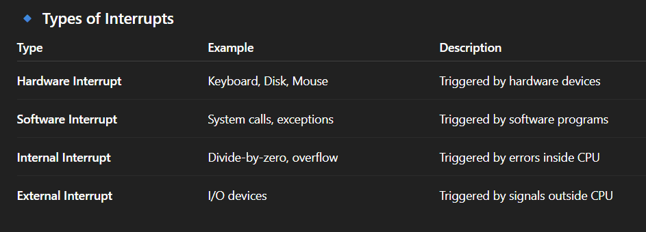
What Is an Interrupt?
An interrupt is a signal sent to the CPU that temporarily stops what the CPU is doing so it can pay attention to something more important.

Slide 12

Operating-System Operations
Bootstrap program – simple code to initialize the system, load the kernel
Kernel loads
Starts system daemons (services provided outside of the kernel)
Kernel interrupt driven (hardware and software)
Hardware interrupt by one of the devices
Software interrupt (exception or trap):
Software error (e.g., division by zero)
Request for operating system service – system call
Other process problems include infinite loop, processes modifying each other or the operating system

Slide 13
Multiprogramming (Batch system)
Single user cannot always keep CPU and I/O devices busy
Multiprogramming organizes jobs (code and data) so CPU always has one to execute
A subset of total jobs in system is kept in memory
One job selected and run via job scheduling
When job has to wait (for I/O for example), OS switches to another job

Slide 14
Job scheduling
Job scheduling means deciding which job (task or program) should run next on the CPU and when it should run. It is one of the main functions of an operating system (OS) to manage CPU time efficiently when there are many jobs waiting to be executed.
The OS uses job scheduling to:
Make sure all jobs get a fair share of CPU time
Maximize CPU usage
Reduce waiting time for users

Slide 15
Multitasking (Timesharing)
1. From Batch → to Time-Sharing
Batch system: The computer runs one job at a time. Users submit jobs (e.g., programs) and wait until it’s completely done. → No interaction, long waiting time.
Time-sharing system: The CPU switches between many jobs quickly, giving each job a tiny slice of time (milliseconds). This happens so fast that users feel like their programs run continuously and can interact with the system instantly.
Result: You can type commands and get responses almost immediately — like using a modern computer or terminal.

Slide 16
Dual-mode Operation
What Is Dual-Mode Operation?
Computers have two modes of operation to keep the system safe and stable:
User Mode – where normal programs (like games, browsers, etc.) run.
Kernel Mode – where the operating system (OS) runs and controls hardware.

Slide 17

Timer
How a Timer Works
The OS sets a time limit (called a time slice or quantum) for a process — for example, 100 milliseconds.
The timer counts down while the process is running.
When the timer reaches zero:
It sends an interrupt to the CPU (called a timer interrupt).
The CPU stops the current process.
The OS takes control and decides which process should run next (CPU scheduling).
This process happens very quickly, so users feel like all programs are running at the same time.

